Slide 1
Reputation and Sudden Collapse in Secondary Markets
Discussion by
Andy Neumeyer
Universidad Torcuato Di Tella

Slide 2
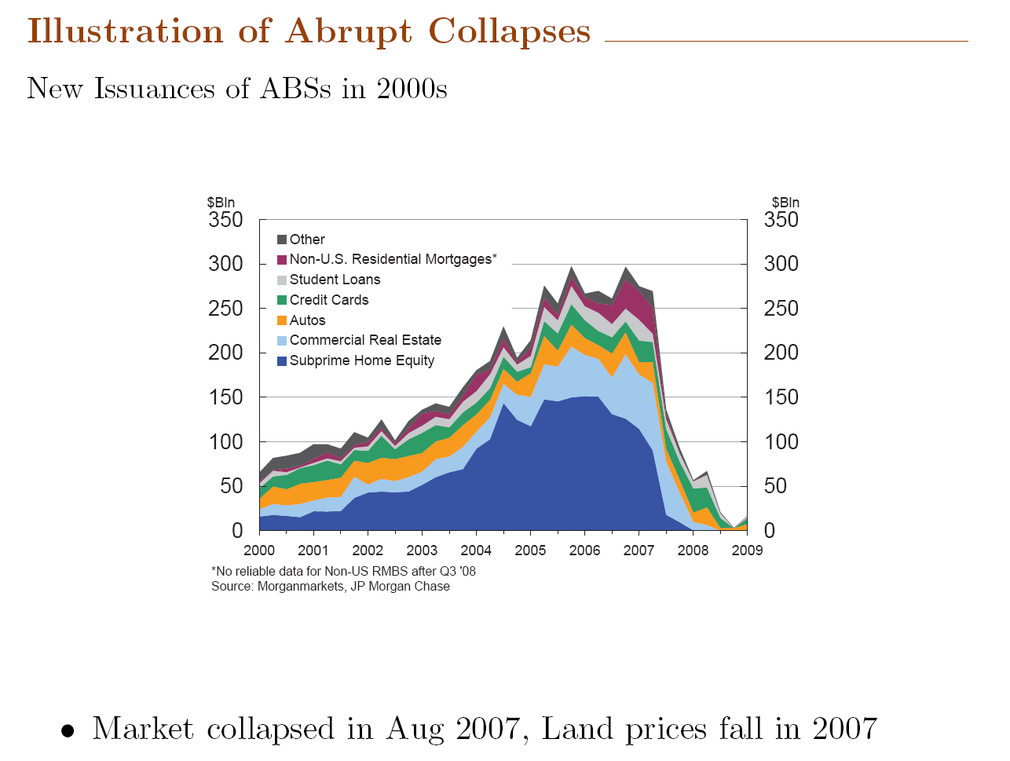

Slide 3
SEC probes second Goldman security
From the Financial Times. June 9 2010 23:42
“The US Securities and Exchange Commission has stepped up its inquiries into a complex mortgage-backed deal by Goldman Sachs that was not part of the civil fraud charges filed against the bank in April, according to people close to the matter.
SEC interest in Hudson Mezzanine Funding, a $2bn collaterised debt obligation, comes amid settlement talks with Goldman over accusations that the bank defrauded investors in Abacus, a similar CDO.”

Slide 4
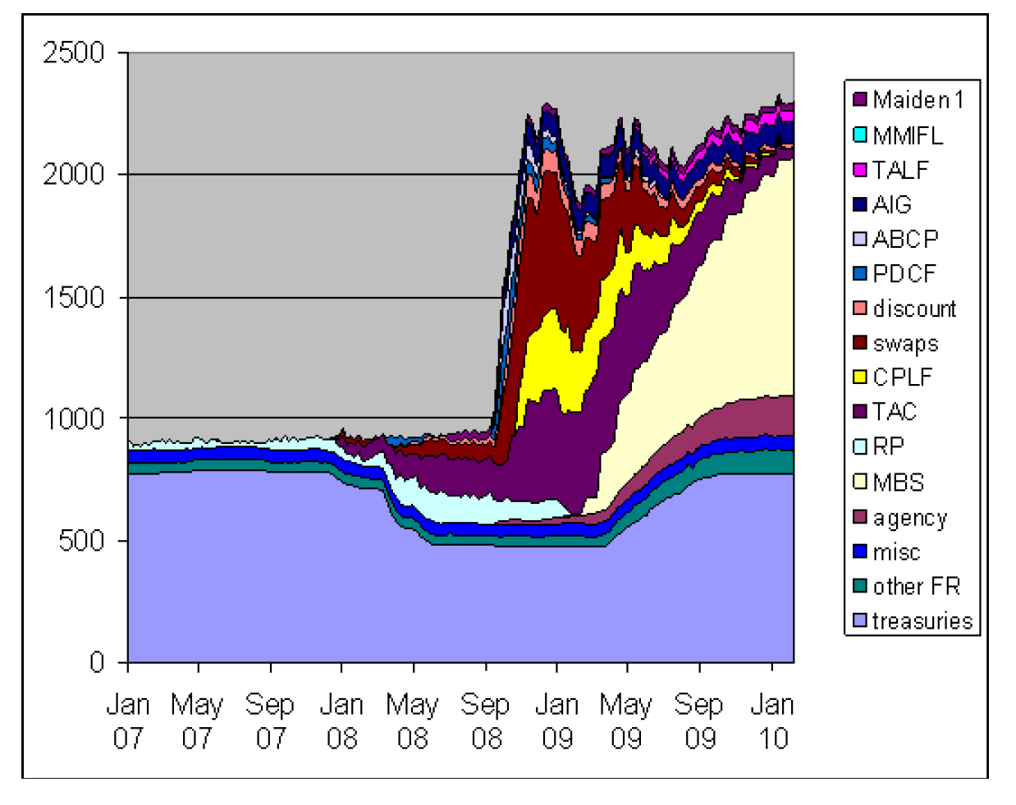
Federal Reserve’s Assets

Slide 5
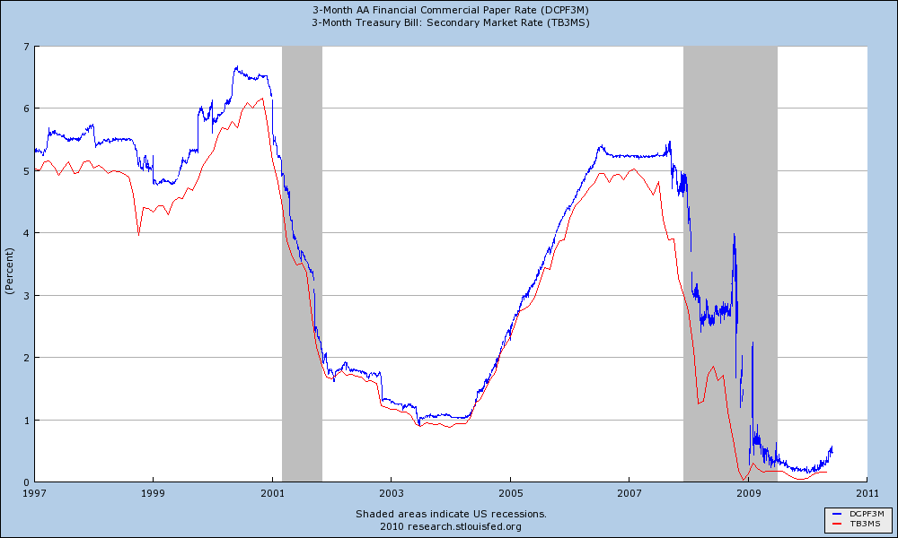
Interest Rates

Slide 6
Main Conclusions of the paper
Adverse selection => multiple equilibria in secondary markets for loans
  Equilibrium refinement selects among these equilibria with signals on colateral values
Policies implemented in 2008 are either bad or irrelevant
  Asset purchases
  Low interest rates

Slide 7
Main points of discussion
Interpretation of secondary market
  Highlight some modelling choices: assume that new issues of ABS have the same distributions of returns over time.
Show some data
  Collateral values
  Interest rates

Slide 8
Interpretation of Secondary Market
Mortgages
Car Loans
Student Loans
Credit Cards
Sells ABS (with possibly complex payoff)
Buys assets with a cost q
ABS Originator
Buyer

Slide 9
Interpretation of Secondary Market
Mortgages
Car Loans
Student Loans
Credit Cards
Sells ABS (with possibly complex payoff)
Buys assets with at cost q
ABS Originator
Buyer
perfect information
imperfect information

Slide 10
Interpretation of Secondary Market
Mortgages
Car Loans
Student Loans
Credit Cards
Sells ABS (with possibly complex payoff)
Buys assets with at cost q
ABS Originator
Buyer
perfect information
imperfect information
FRAGILE MARKET

Slide 11
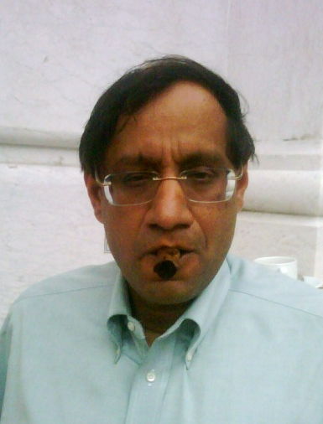
Interpretation of Secondary Market
Mortgages
Car Loans
Student Loans
Credit Cards
Sells ABS (with possibly complex payoff)
Buys assets with at cost q
Buyer
perfect information
imperfect information
Goldman Chari
FRAGILE MARKET

Slide 12
Setup of the Model
ABS Originator
Sells ABS
Buyer

Slide 13
Static Model
Secondary market exists iff ABS originator sells (is active)
Perfect information: only costs matter
Assumption on returns

Slide 14
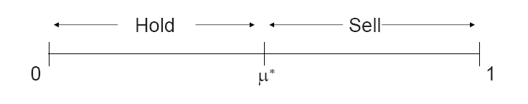
Static Model
Imperfect information (lemmons): there is trade iff

Slide 15
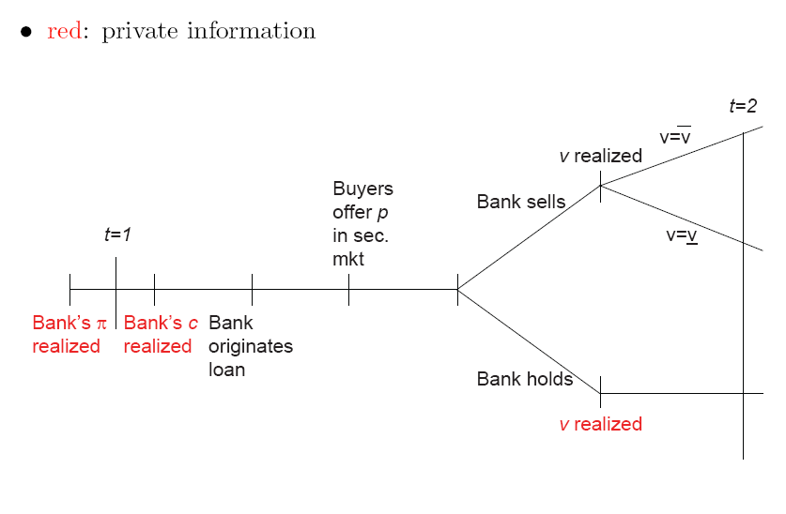
Dynamic Model
In t = 2
New buyer observes payoff of ABS in t = 1
ABS originator issues ABS with same (π, c) of t = 1
Beliefs μ₂ depend on actions and v realizations in t =1

Slide 16
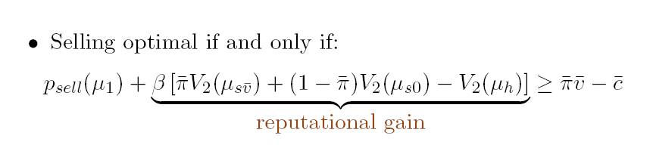

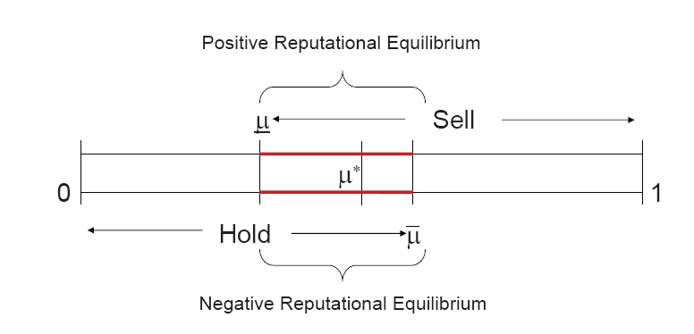
Dynamic Model

Slide 17
Dynamic Model: crucial assumptions
ABS assembled by originator has always the same (π, c)
  Otherwise no Bayesian learning → all results collapse
Other interpretation: update about whether the ABS originator truthfully disclosed the distribution
  What if the incentives to lie change over time ?

Slide 18
If I take the Model Seriously . . .

Slide 19
Illustration of abrupt collapses
All ABS collapse in 2007
Auto ABS, credit cards and student loans revive in first half of 2008
Collapse in september 2008

Slide 20
Why did auto ABS market collapse in 2007?

Slide 21
Interest Rates
ABS Originator
Sells ABS
Buyer

Slide 22
Interest Rates (static model)
Payoff
sell
hold
r*
Interest Rate
Market collapse

Slide 23
Interest Rates (Dynamic Model)
μ
Multiple Equilibrium
μ₀
μ*
μ
r*
Interest Rate

Slide 24
Interest Rates in the Paper
Why collapse in 2007 and not in 2001?
  More discipline on μ?

Slide 25
Conclusions
Do we think that distributions of returns on ABS are constant over time across new issuances?
Do more work in terms of matching model and data

